Slide 1
MidTerm:Data Analysis on FreddieMac Data for US housing market prediction
Submitted by:
Sneha Malshetti
Megha Singh

Slide 2
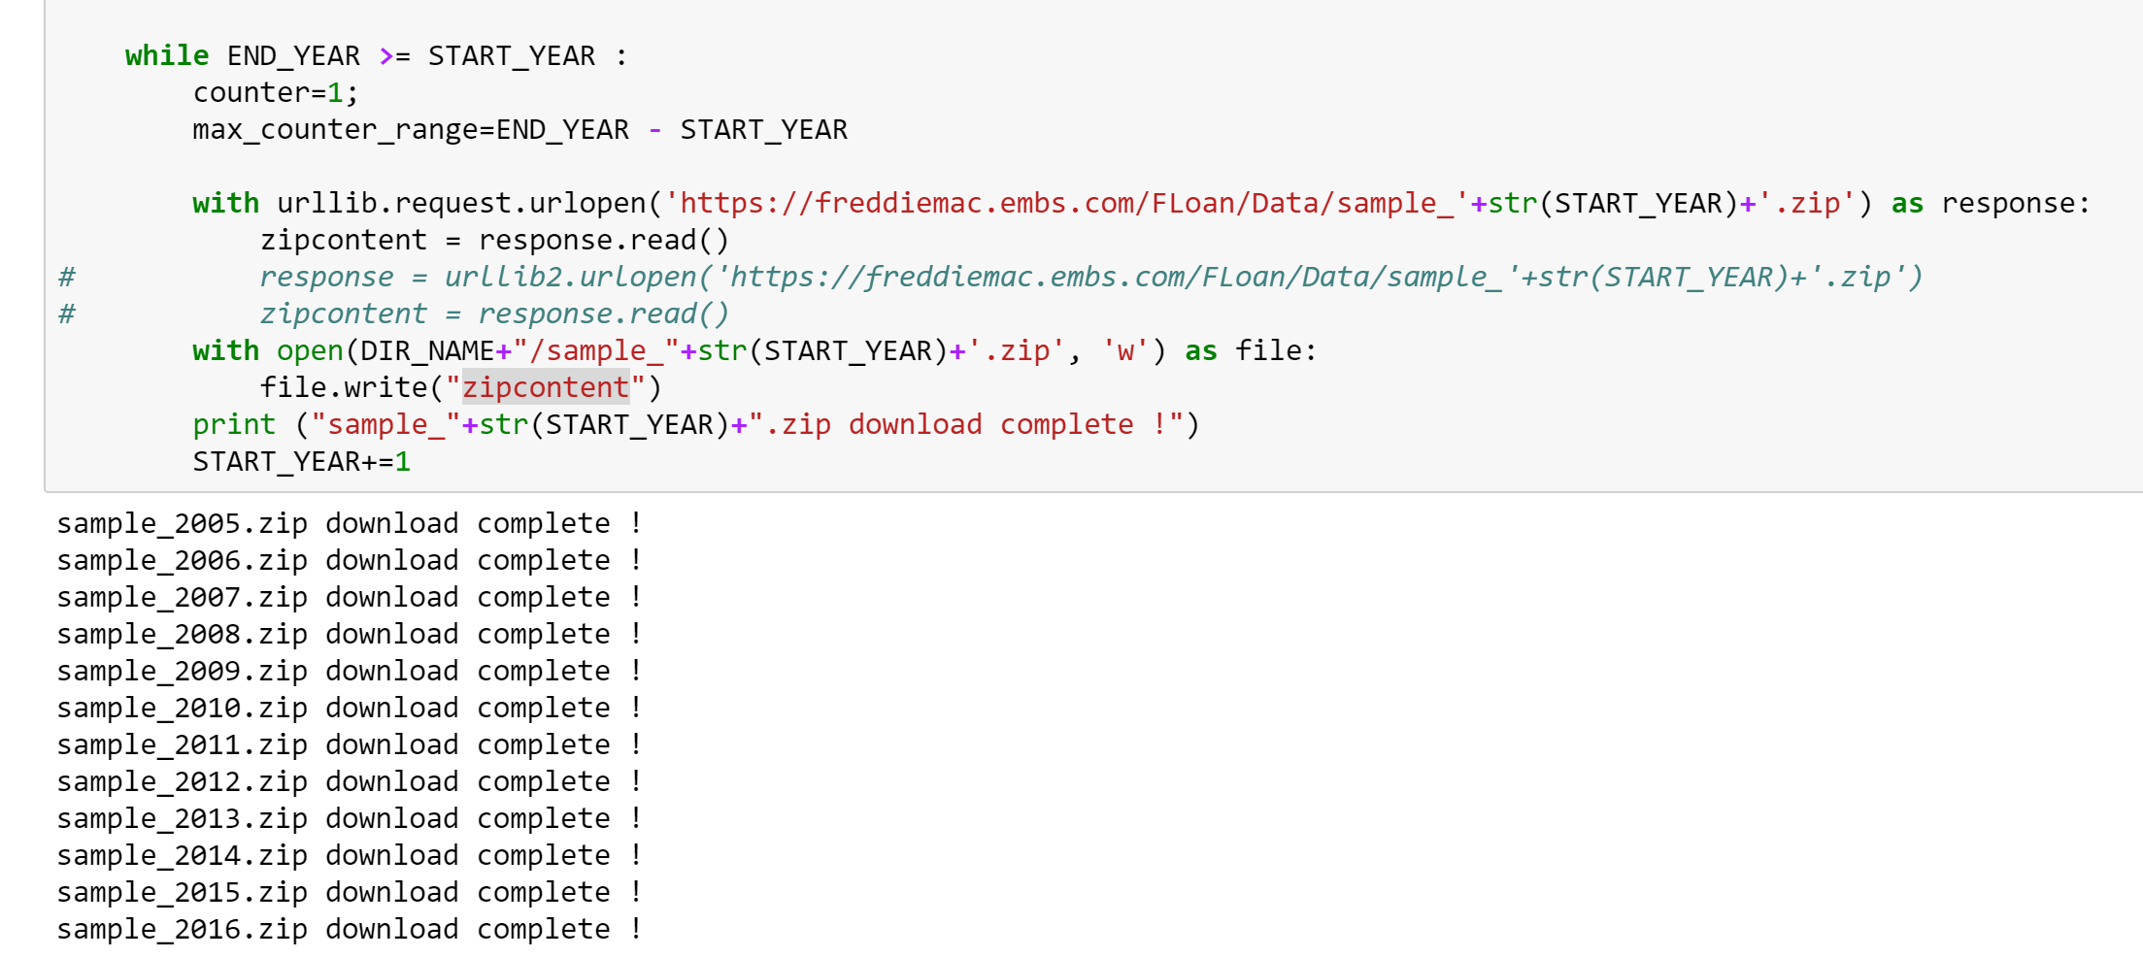
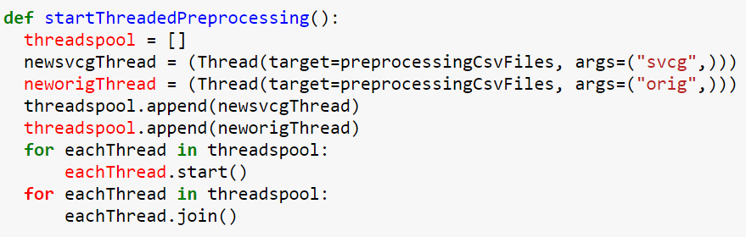
PART 1: Data Ingestion and pre-processing
To download the file programmatically, we need username and password and also bypass the terms&condition page:
So need to store them in the request session so that user didn’t redirect back to the login page whenever required to download a file from the Freddie Mac posted dataset.
The user is logged in to the website, we created an empty thread pool where the request for every thread is passed for each file and looped through yearly.
While accessing each file It creates a lock for each thread, hence whenever a file is being downloaded and processed it will not simultaneously conflict with the other thread.
Once its downloaded all the sample zip ,extracts data from all zip file and puts in the csv files

Slide 3
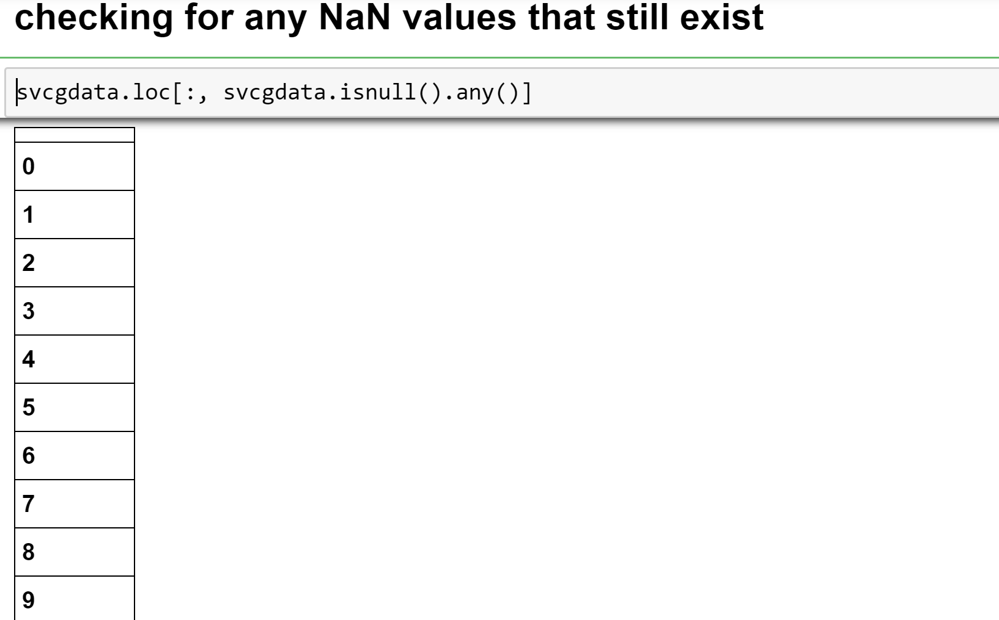
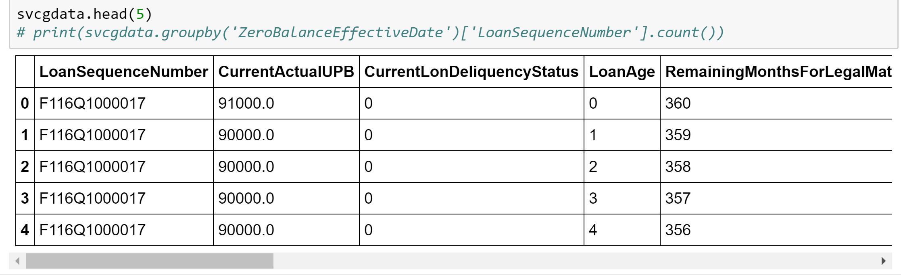
Data Wrangling
We select all the columns which are required and delete the rest of the columns using pandas
The dataset is having lot of Null and no values at all, So we check for any null values/missing values and remove them
Filling the missing Values with proper numeric values
Saving the wrangled and cleaned data file locally for further EDA and other processing
All the NaN values are removed and when we check for the values I looks as below
For further processing on data, we try converting the datatypes into their respective expected data type as below
We follow the same steps for the Orig file and then save the data frames as CSV file
In origination file, we have idloan which is a unique loan sequence number with quarter and year of loan origination attached to it.
In performance file, for a given year we have multiple rows associated with a loan number which depicts its performance.

Slide 4
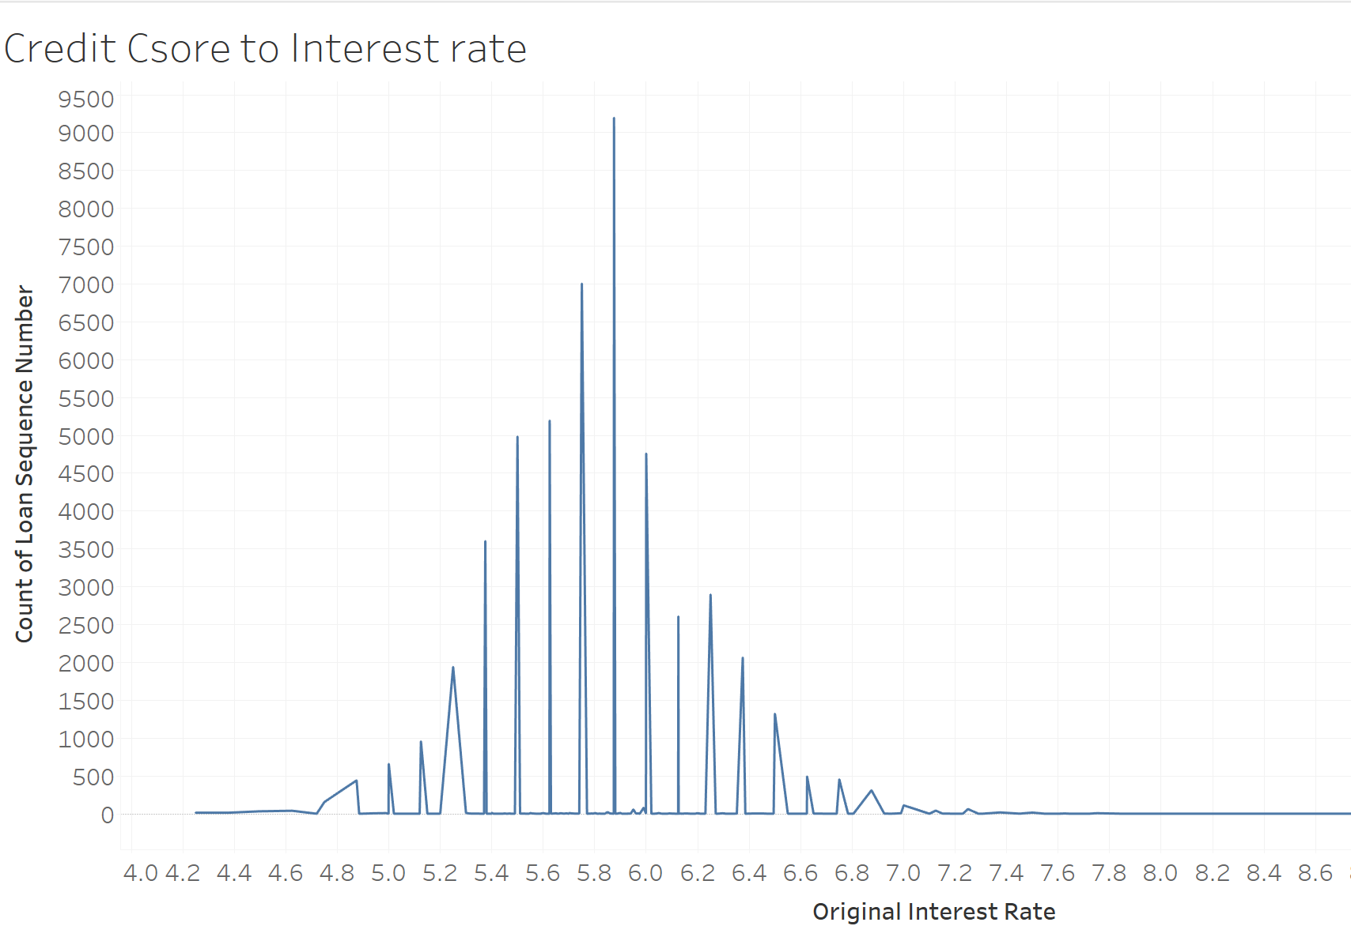
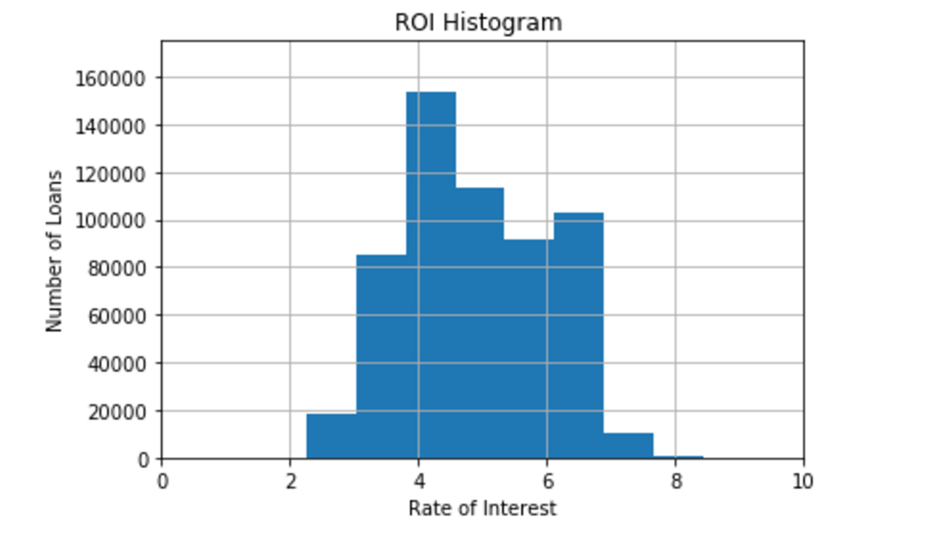
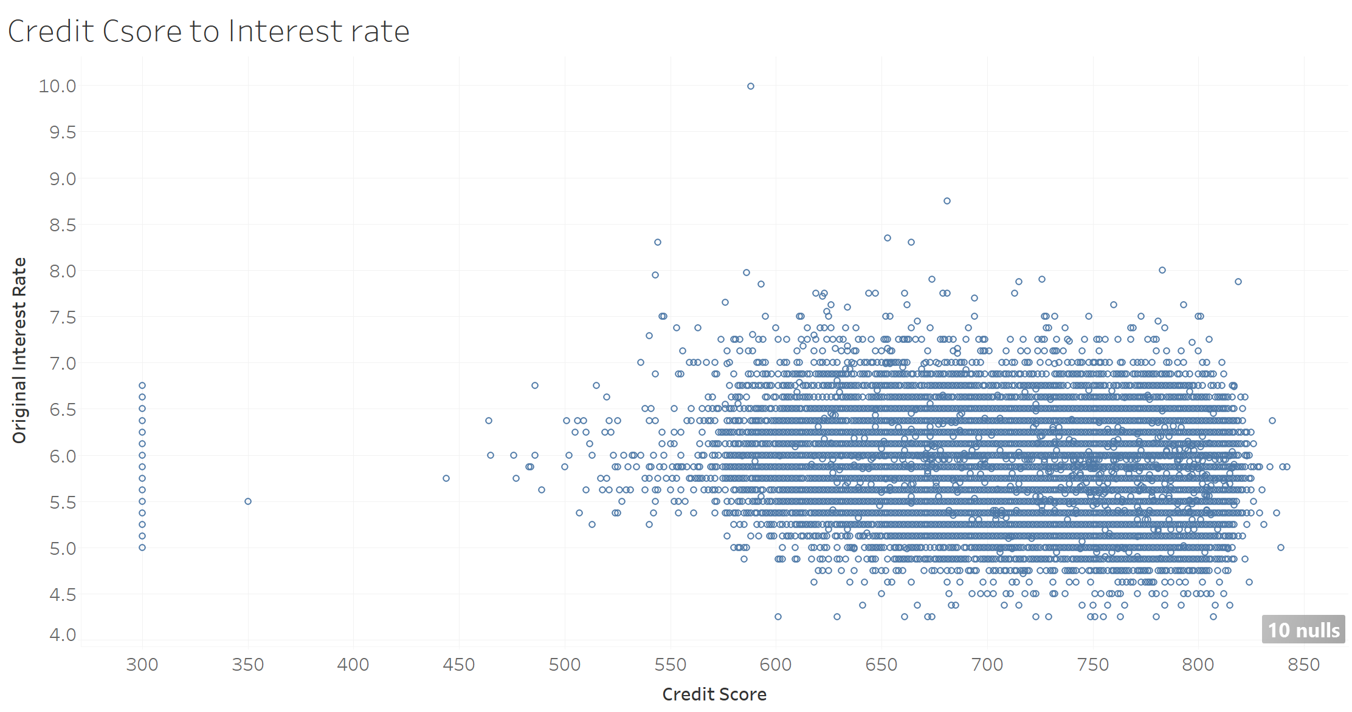
Exploratory Data Analysis :
Graph 1: Credit Score to Interest Rate : it shows the direct relation between the customer credit history with the interest rate, maximum and minimum range for the RATE of Interest for the sample year is 4.7 - 7.0 range
Graph2: The graph above gives a scatter plot and we can reckon that the people in the categore between 550 to 830 get most loans while the interest rate is distributed between 4.5 to 7.

Slide 5
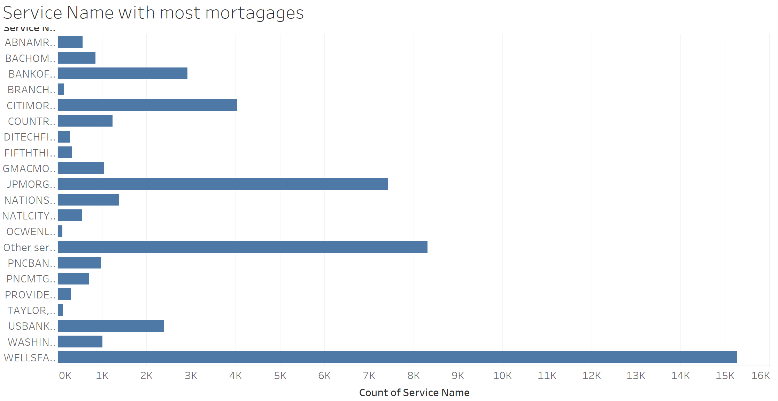
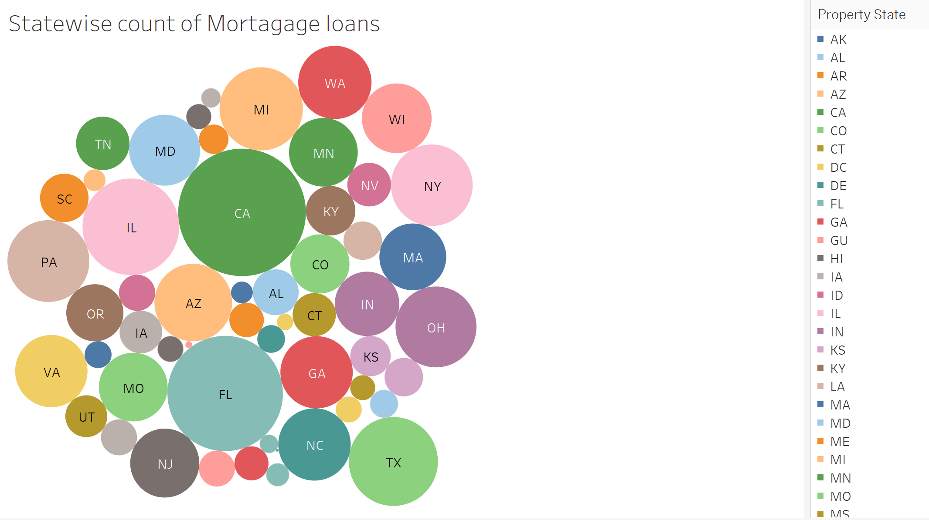
Graph1: Freddie mac dataset we observed the most number of mortgage service Compnies are : shows the number of loans taken under the various service providers.
Graph2: here we can analyze the maximum number of mortgage loans are in which sates : California, Florida are the major cities with maximum number of mortgage loan customer

Slide 6
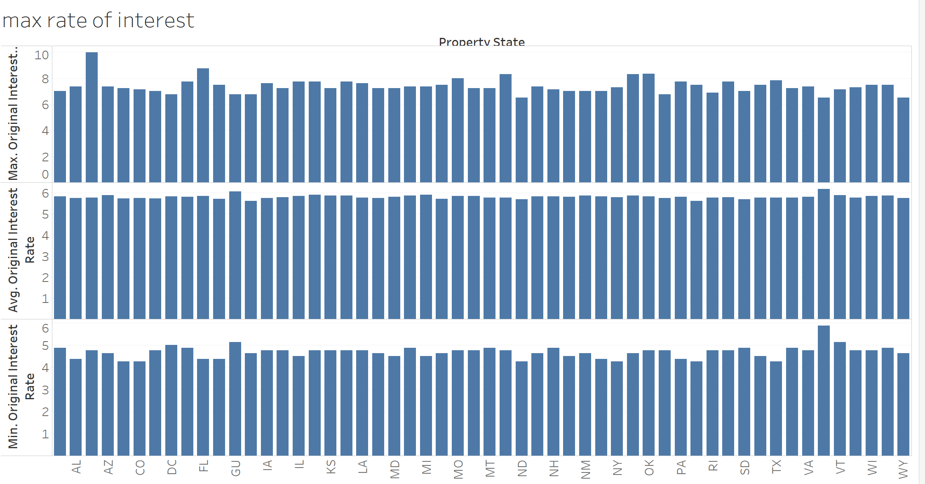
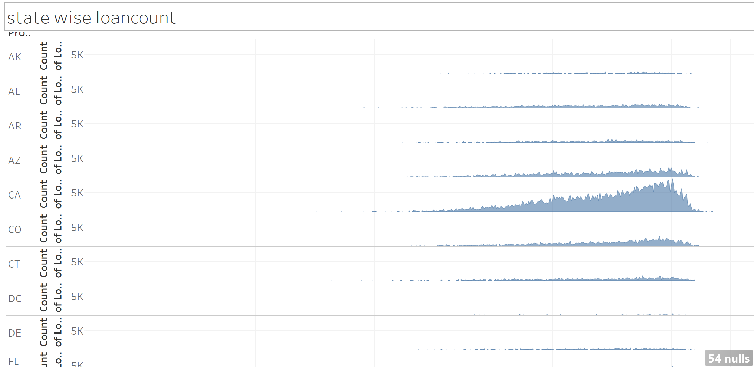
This graph represents the interest rate various according to state: As the state changes the Rate of Interest also varies : here it shows the average max and minimum amount of ROI paid in the country according t the different states.
Graph 2 :This shows the amount of mortgage loan is offered in every states. And we can observe here California is having the maximum amount of mortgage loan

Slide 7
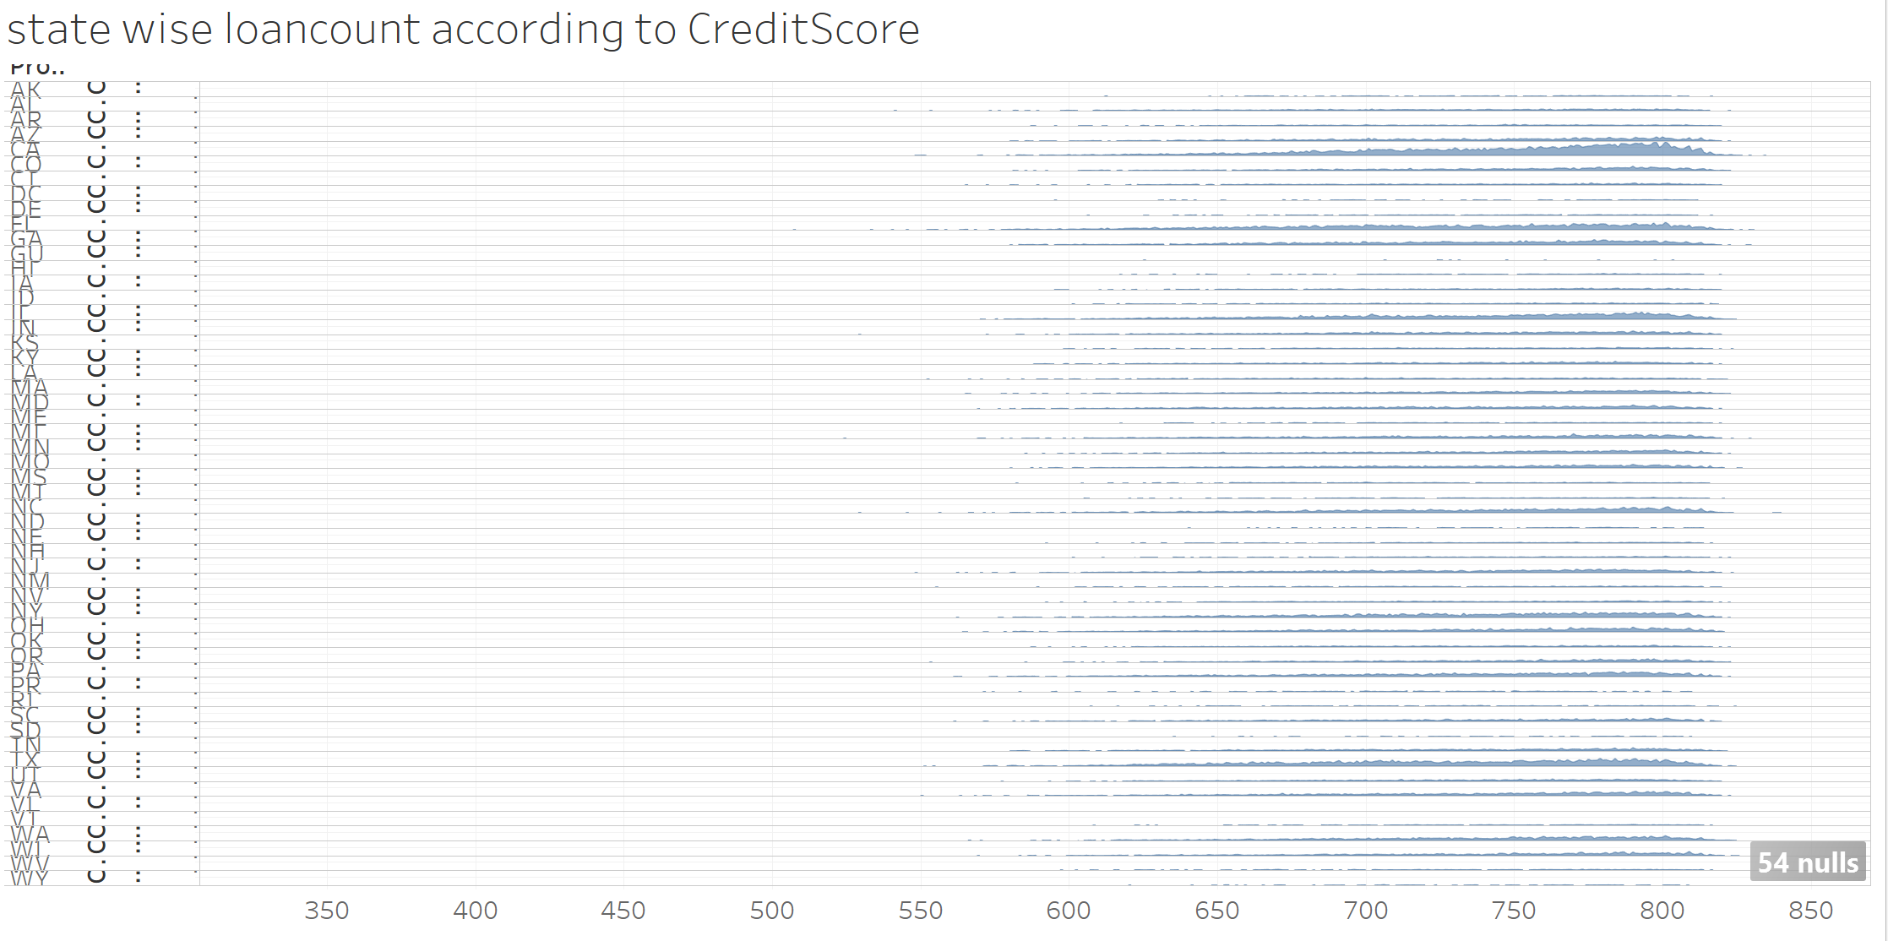
graph represents the state which is having maximum number of people with credit score , as more the number of population with better credit score reflects the better income
the statewise loan count according to the credit scores of the customers. The graph shows that California had the most loans taken for the credit score of 787
Summary:
CREDIT SCORE declined as the interest rate increases , so in later years the interest rate is higher , customer with avaerge of 301-850 Credit score will have approximately 6% of Interest Rate on mortgage loans.
Most number of loan count is also having the maximum amount of mortgage loan with credit score ranging 301-850
Nationwide banks have the most number of customer with mortgage loans and having more principle amount of loan
California and Florida had the most loans taken for the credit score of 787

Slide 8
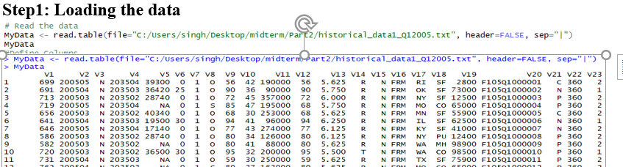
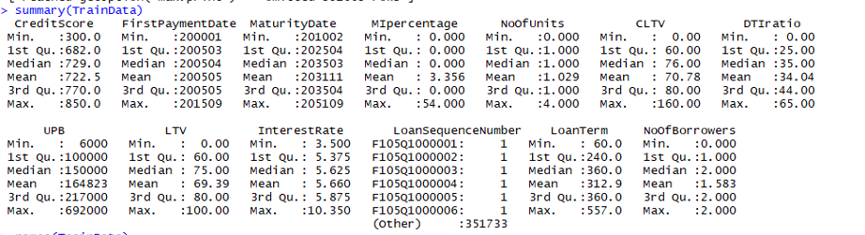
PREDICTION (Predicting Interest Rates)
Preprocessing the dataset
Fetching the dataset and preprocessing it.
Removing the NA and replacing the missing values
Make sure the dataset doesnot have NA and Non numeric values for analysis

